Slide 1
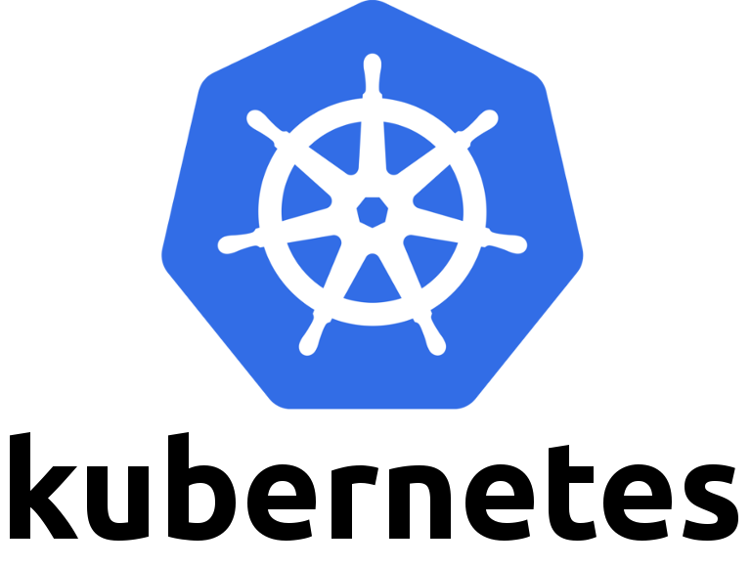
Steps to deploy bookinfo application
1) Installing minikube
2) Installing kubernetes via minikube
3) Installing istio over kubernetes
4) Deploying bookinfo application
For detailed steps to deploy the application refer-
https://istio.io/docs/examples/bookinfo/
This Photo by Unknown author is licensed under CC BY-SA.

Slide 2
Istio
Istio is an open source framework for connecting, monitoring, and securing microservices, including services running on Kubernetes Engine. It lets you create a network of deployed services with load balancing, service-to-service authentication, monitoring, and more, without requiring any changes in service code
Istio is an Open Source project (developed in partnership between teams from Google, IBM, and Lyft) that solves all the following problems:
-Traffic management: Timeouts, retries, canary rollouts,
-Security: End-user Authentication and Authorization,
-Observability: Tracing, monitoring, and logging

Slide 3
pod
A Pod is the basic building block of Kubernetes–the smallest and simplest unit in the Kubernetes object model that you create or deploy. A Pod represents a running process on your cluster.
A Pod encapsulates an application container (or, in some cases, multiple containers), storage resources, a unique network IP, and options that govern how the container(s) should run.

Slide 4
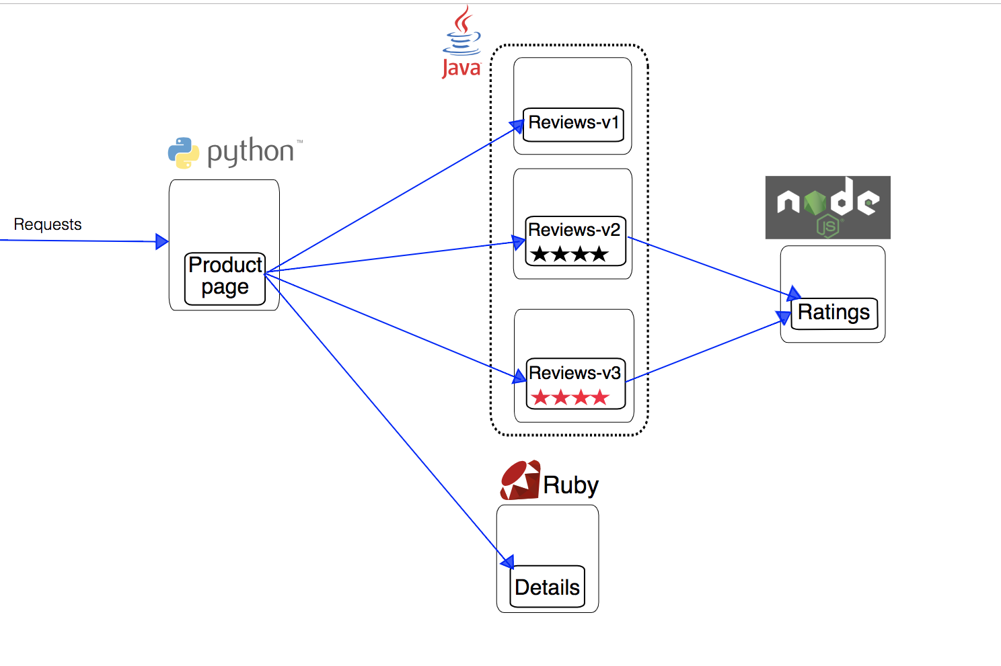
Bookinfo Architecture

Slide 5
Virtual service and destination rule
A VirtualService defines the rules that control how requests for a service are routed within an Istio service mesh.
A DestinationRule configures the set of policies to be applied to a request after VirtualService routing has occurred.

Slide 6
What virtual service can do ?
What destination rule does ?
For example,you can implement a simple rule to send 100% of incoming traffic for a reviews service to version “v1” by using a VirtualService configuration.
In a DestinationRule, you can then add additional policies. For example, we can define our service to use the random load balancing mode.

Slide 7
Splitting traffic between versions
We can split the traffic influx by the rule which will route x%( say x=25) of traffic for the reviews service to instances with the “v2” label and the remaining y% (here y=75) of traffic to “v1”.
What we need to do is that assign a value to 'weight' parameter corresponding to every lebel in virtual service configuration file.
By default splitting of traffic is done in round-robin manner.

Slide 8
A/B Testing
A/B testing (also known as split testing or bucket testing) is a method of comparing two versions of a webpage or app against each other to determine which one performs better.
AB testing is essentially an experiment where two or more variants of a page are shown to users at random, and statistical analysis is used to determine which variation performs better for a given conversion goal.

Slide 9
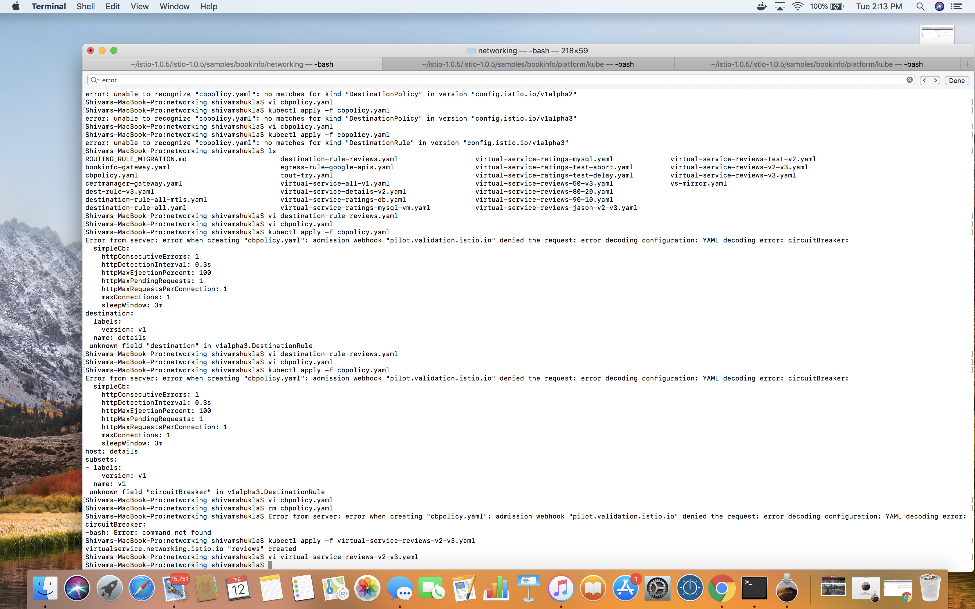
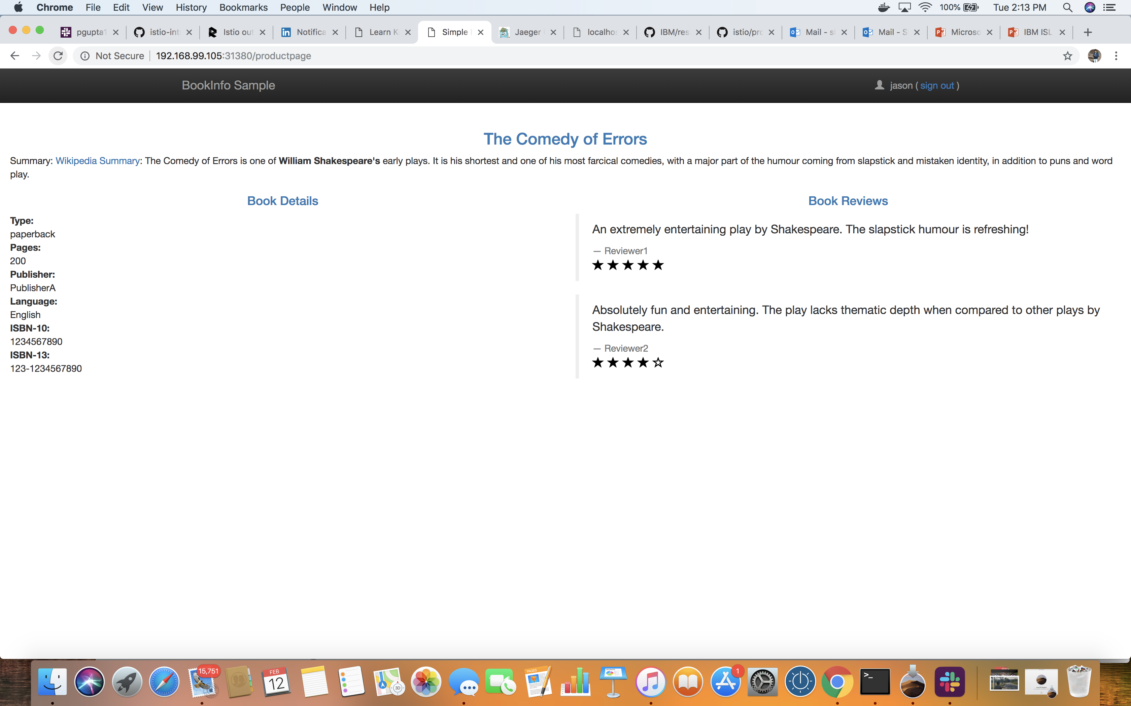
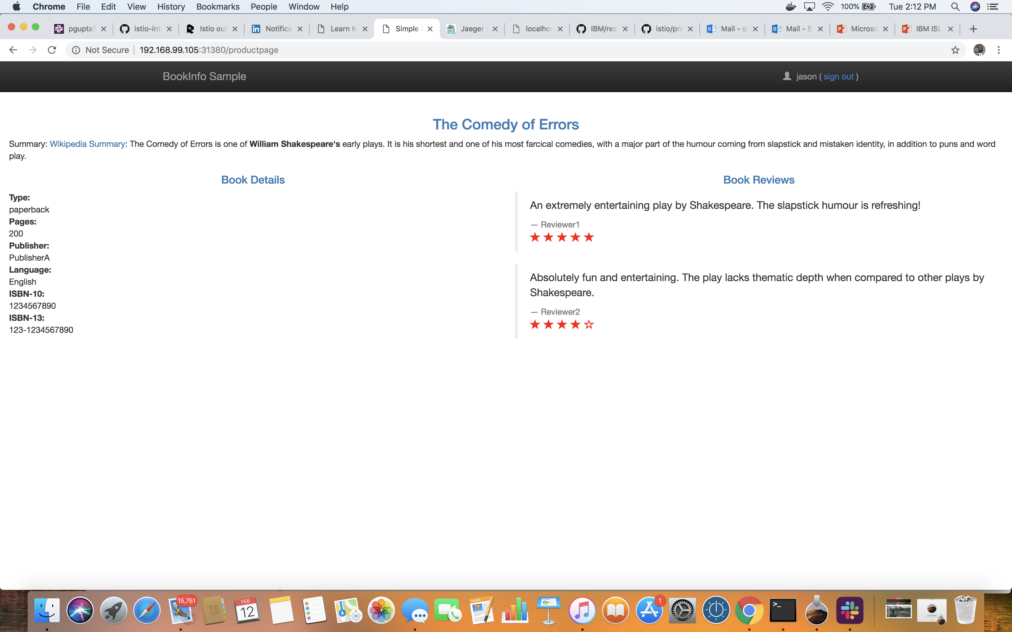
A/B Testing [command line]

Slide 10

Canary deployment
Canary Deployment - is the process of rolling out a new version of an application to a small set of users, as a step to verify the absence of issues, and then with a higher assurance of quality release to the wider audience.
Let’s continue with our different versions of bookinfo to demonstrate canary deployments, by boldly sending 20% of the users to version2 (this represents the canary deployment) and 80% to version1 by applying the VirtualService .
VirtualServices enable Canary Deployments and with this method, we reduced potential damages to 20% of our user base.

Slide 11
Authentication
Provides each service with a strong identity representing its role to enable interoperability across clusters and clouds.
Secures service-to-service communication and end-user-to-service communication.
Provides a key management system to automate key and certificate generation, distribution, and rotation.

Slide 12
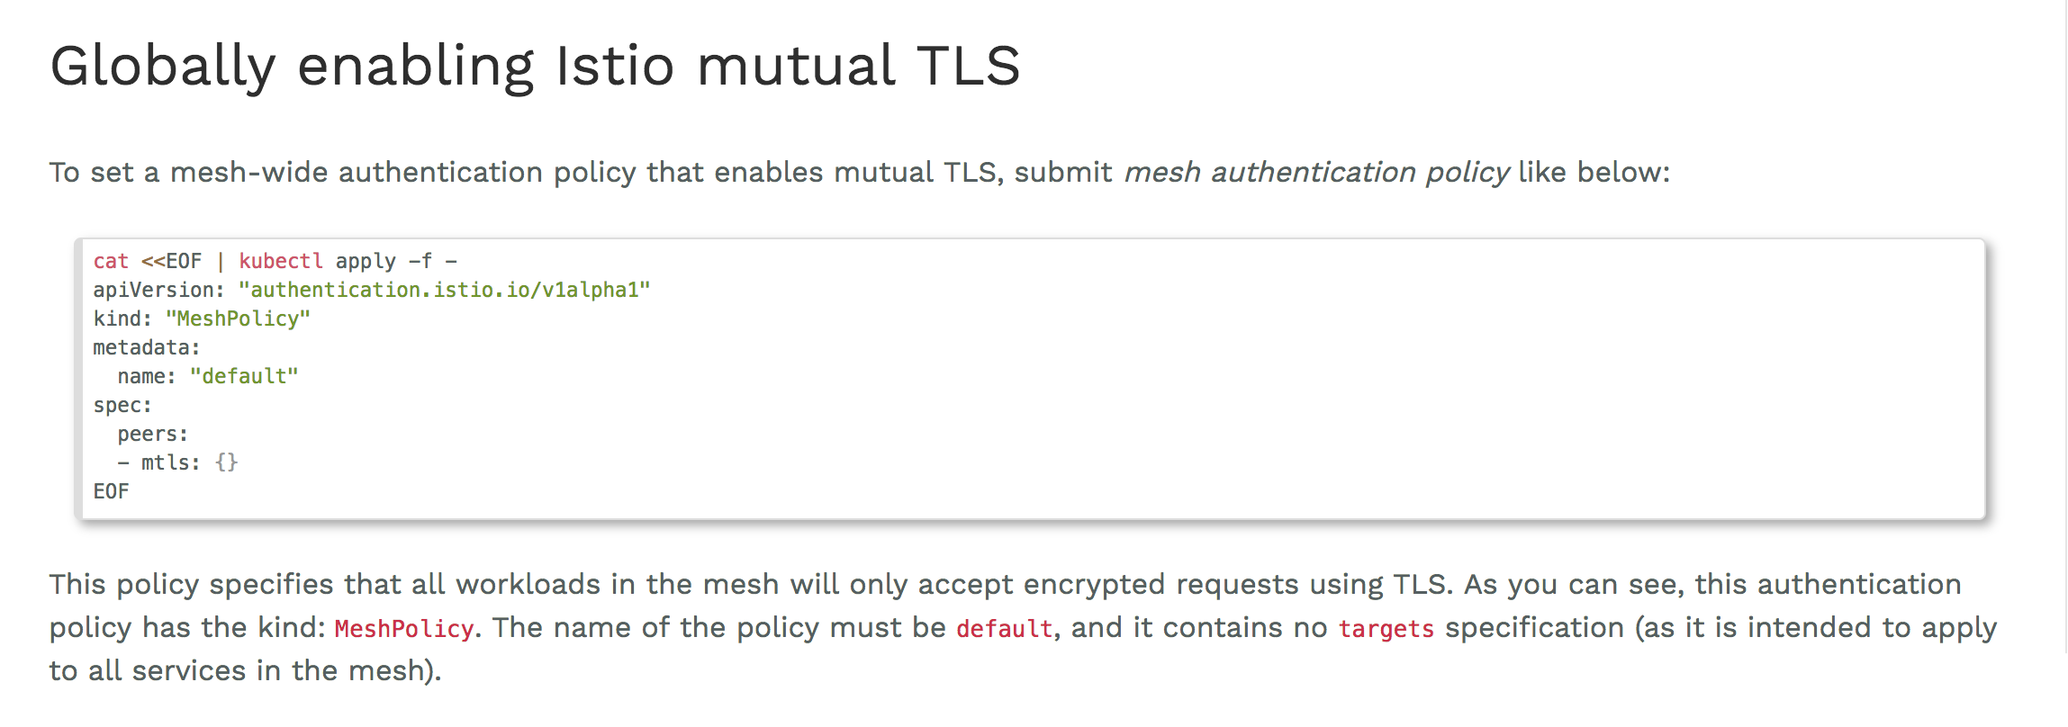
Default MeshPolicy

Slide 13
Authorization
Istio’s authorization feature - also known as Role-based Access Control (RBAC) - provides namespace-level, service-level, and method-level access control for services in an Istio Mesh.
To configure an Istio authorization policy, you specify a ServiceRole and ServiceRoleBinding. Like other Istio configuration objects, they are defined as Kubernetes CustomResourceDefinition (CRD) objects.
ServiceRole defines a group of permissions to access services.
ServiceRoleBinding grants a ServiceRole to particular subjects, such as a user, a group, or a service.

Slide 14
Service account-
Kubernetes enables access control for workloads by providing service accounts. A service account represents an identity for processes that run in a pod.
When a process is authenticated through a service account, it can contact the API server and access cluster resources.

Slide 15
Timeouts and Retries
To improve the user experience we could:
-Timeout if the service takes longer to respond and
-Retry on failed requests.
> By default, the timeout for HTTP requests is 15 seconds, but it can be overridden in a route rule.
> You can also specify the number of retry attempts for an HTTP request in a route rule. The maximum number of retry attempts, or the number of attempts possible within the default or overridden timeout period, can also be set.

